Slide 1
Price Prediction for Mobile Phones
feature extraction analysis to identify the most influential features.

Slide 2
Introduction
In today's fiercely competitive mobile phone market, understanding the factors that drive pricing is crucial for businesses to stay ahead.
This project focuses on leveraging detailed information about mobile phone specifications to develop a predictive model for estimating mobile phone prices accurately.
The dataset encompasses a variety of features including model, colour, memory, RAM, battery capacity, camera specifications, presence of AI lens, mobile height, and processor, with price being the primary target variable.
We aim to uncover the key determinants influencing mobile phone prices. Through this analysis, our objective is to provide valuable insights that can inform pricing strategies and enhance decision-making processes in the dynamic landscape of the mobile phone industry.

Slide 3
Dataset overview
Our dataset comprises comprehensive information about various mobile phones, providing insights into the factors influencing their prices in today's competitive market. The key features included in the dataset are:
Model(specific model or brand), Colour(Indicates the colour variants), Memory( Denotes the storage capacity)RAM: Represents the Random Access Memory (RAM) capacity of the device, Battery Capacity(battery capacity in mAh).
Camera Specifications: Includes details about the rear and front camera specifications.
Presence of AI Lens: Indicates whether the mobile phone is equipped with an Artificial Intelligence (AI) lens for camera functionalities.
Mobile Height: Represents the physical height in millimetres (mm).
Processor: Specifies the processor or chipset used in the mobile phone for processing tasks.
Price: The target variable, representing the price of the mobile phone.

Slide 4
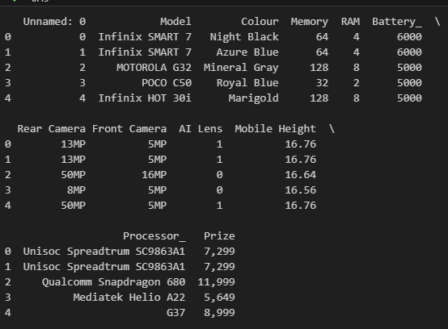
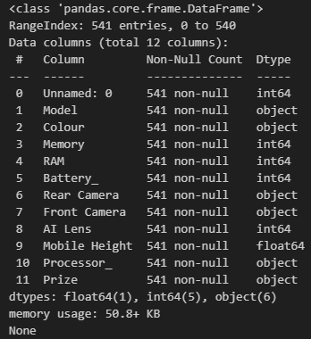
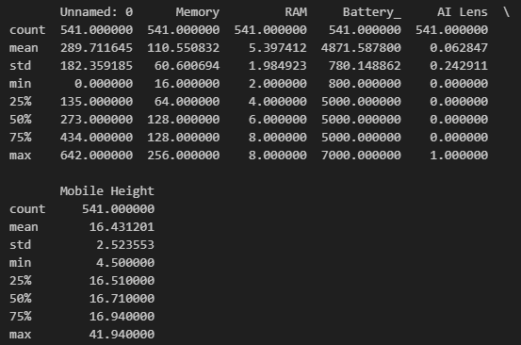
Load and exploration the data
Load the dataset data = Load the data using read.csv commend.
Data Exploration : We use the below commend.
print(data.head())
print(data.info()) print(data.describe())

Slide 5
Data Pre processing

